Slide 1
E-Bike Project
Jeremy Lesmana
ACAD Period 1
Temple City High School

Slide 2
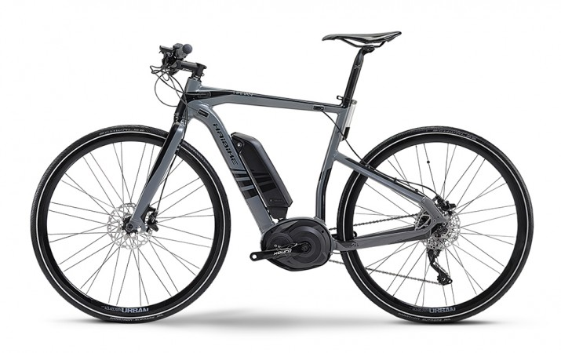
Introduction
Update 1
This project is intended for students to create and design products utilizing themes, mechanical requirements, and a potential audience. With these mechanical components of the product, the project opens a doorway for students to mechanical design and engineering. It is important for students to research various bike models and types which fit to their personal interest.
Time organization is also crucial for this project since students are only given four weeks to complete this project, which requires a lot of time management and structuring.

Slide 3
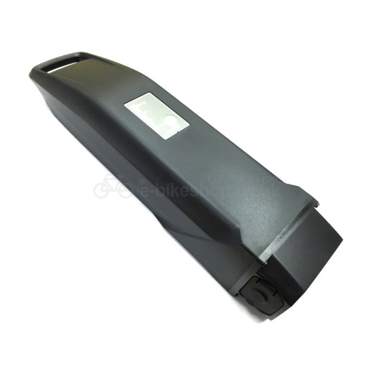
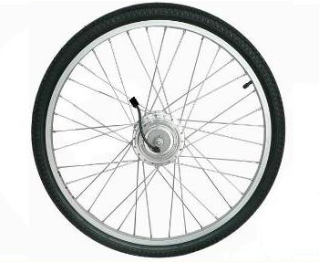
Research
Update 1
The E-Bikes I’m mostly interested in is for use in the urban areas. My E-Bike’s purpose is to improve daily commute going from one destination to the next, therefore I can try to design a cheap bike (without all the extra features off-road bikes would require) and therefore the price could be lower.
I’ve been researching about the different components and how the different parts work, in order to start modeling in Solidworks and putting them together in the assembly. I started focusing on the wheels, motors, batteries, pedals, the body frame itself, and the handlebars.

Slide 4
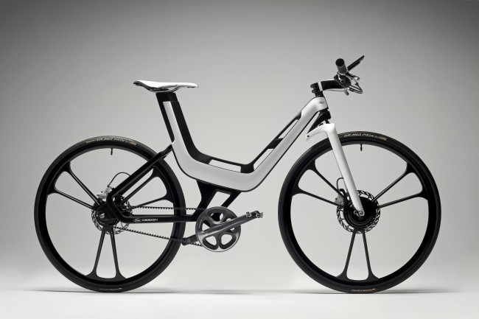
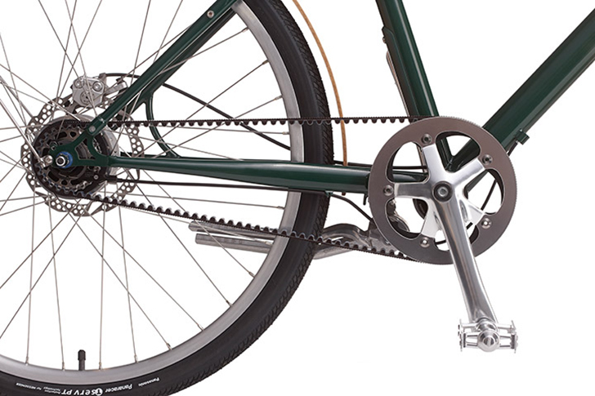
Research
Update 1
My goal is to have a modern looking E-Bike, that is clean, simple, and cheap to make. The reason being is in case any parts are broken, the replacement process would be easy and cheap for customers.
Not only do I want a clean and cheap bike, but I want a bike that allows the customers to customize themselves. I’ve researched the materials of the bike and it seems like I’m going to try to stick with something stainless and glossy on the body material.

Slide 5
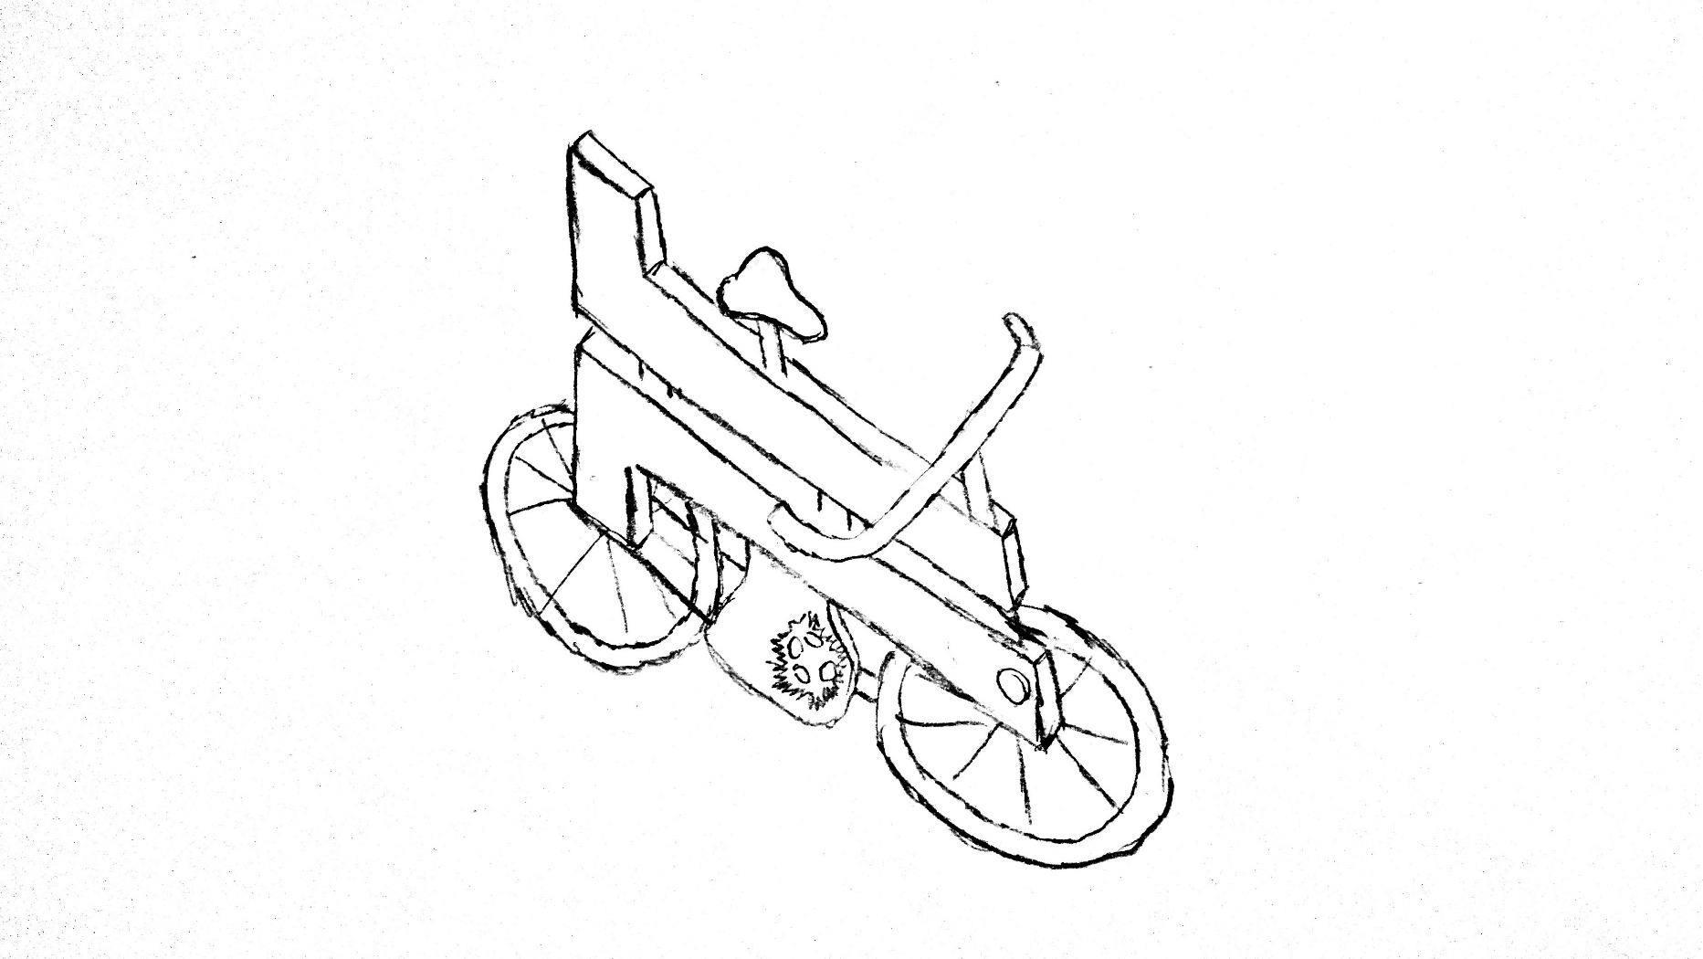
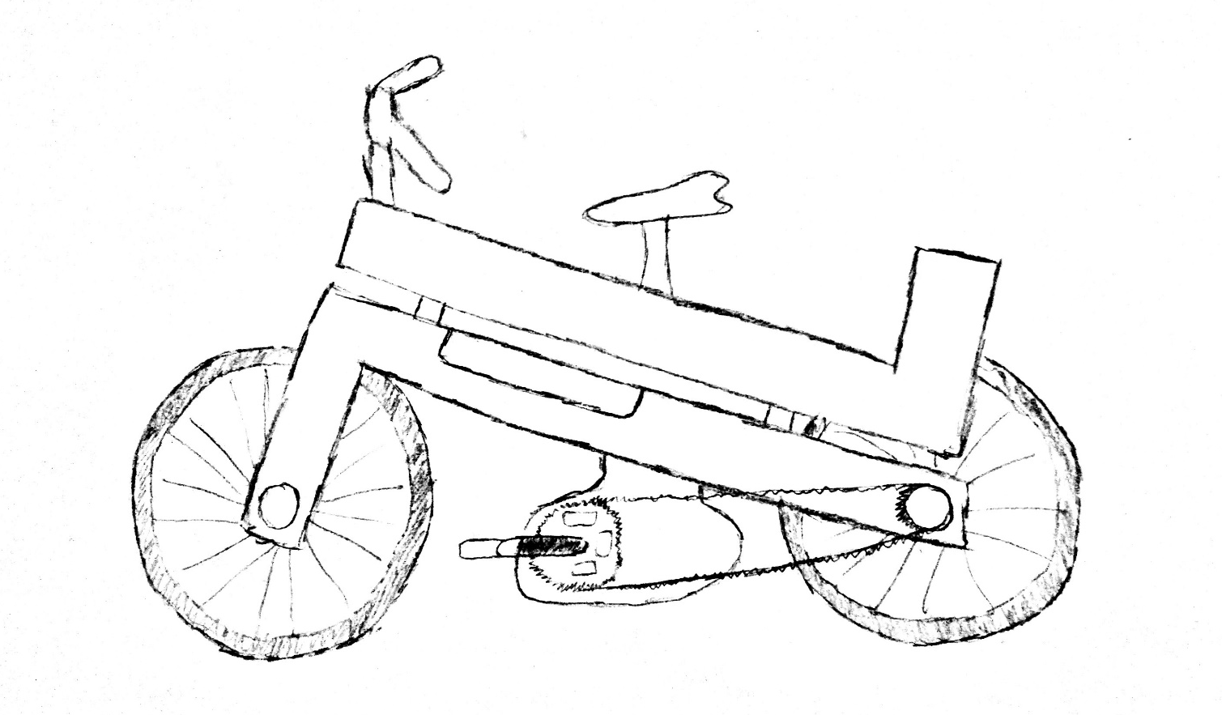
Sketches
Update 1
Seat
Handle Bar
Body
Battery
Pedal
Wheels

Slide 6
Planning
Update 1
Plans for modeling
1st Week: Plan out Sketches, finish simple parts (wheels, rims, etc..), have a concept idea on how bike will look like in the end
2nd Week: Start body, and different components. If not finished then continue on to 3rd Week.
3rd Week: Finish body and component parts; start on the assemblies and fitting pieces together to create the bike
4th Week: Finish assembly, start renderings and hoping to finish all renderings by 4th week.

Slide 7
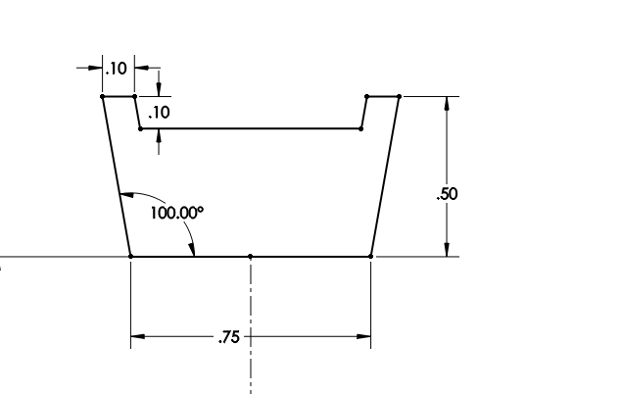
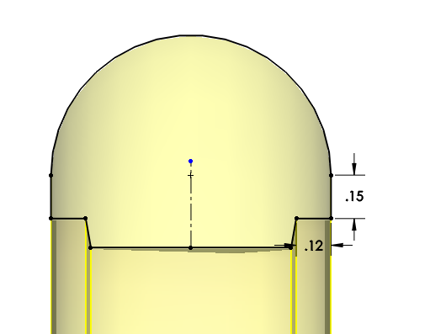
Modeling
Update 1
I started modeling the E-Bikes with the wheels. I started out by sketching out the rim and planning to use the Revolve tool afterwards. After sketching the rim, I also created the outside tire using the revolver tool.

Slide 8
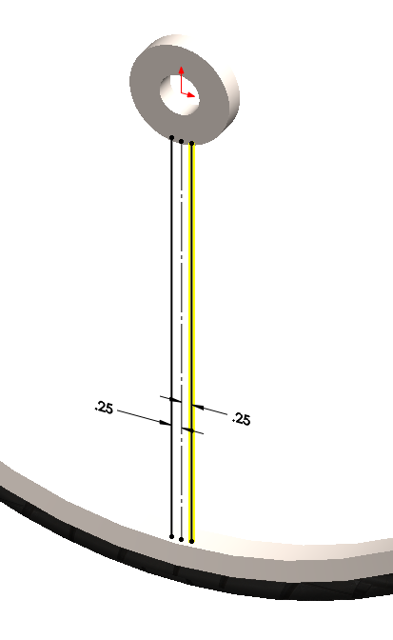
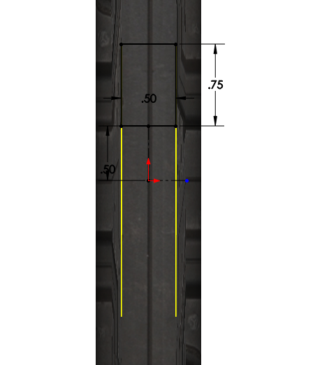
Modeling
Update 1
I then started making the hole in the middle of the wheel to connect the wheels and the chains, and also to connect the spokes to the part. I also created that part utilizing the Revolve Tool. I then drew a line in between the rim and the middle part, and used a Sweep to create the spokes.

Slide 9
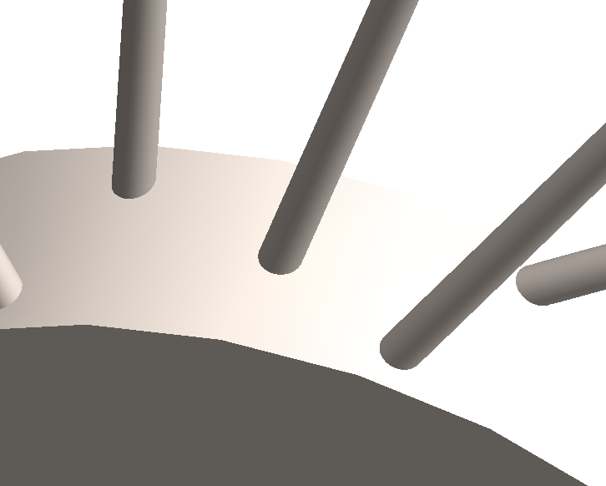
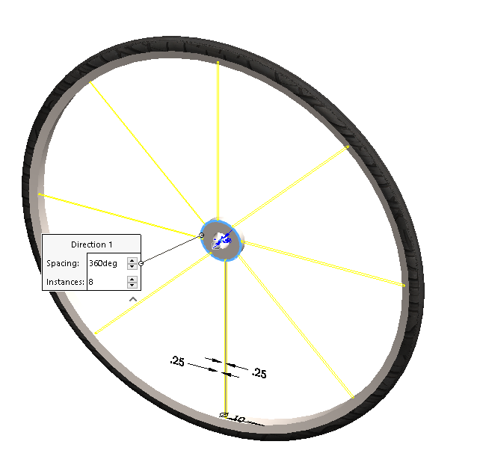
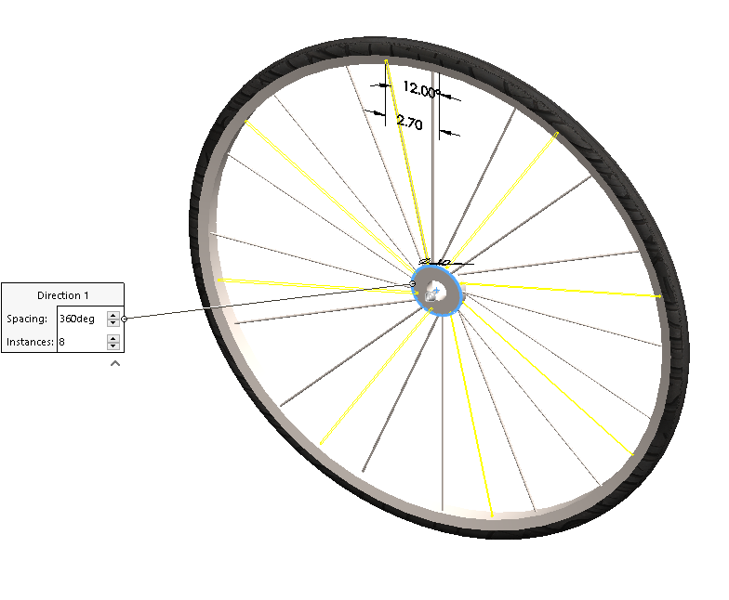
Modeling
Update 1
After the sweep feature, I used the Circular Pattern command to create multiple spokes in the wheel. I ensured that the spokes are not aligned in the same row together to create it more realistic like a “normal” bike. I achieved this effect by creating them in different planes.

Slide 10

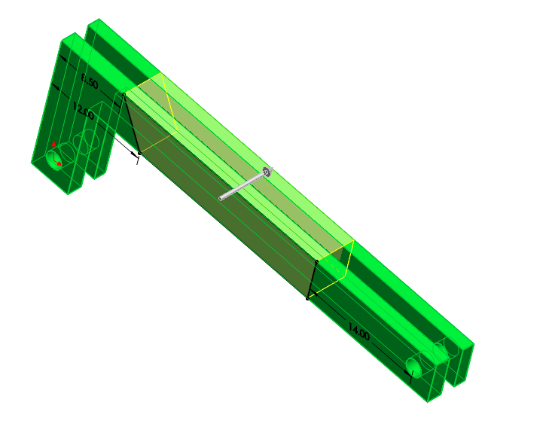
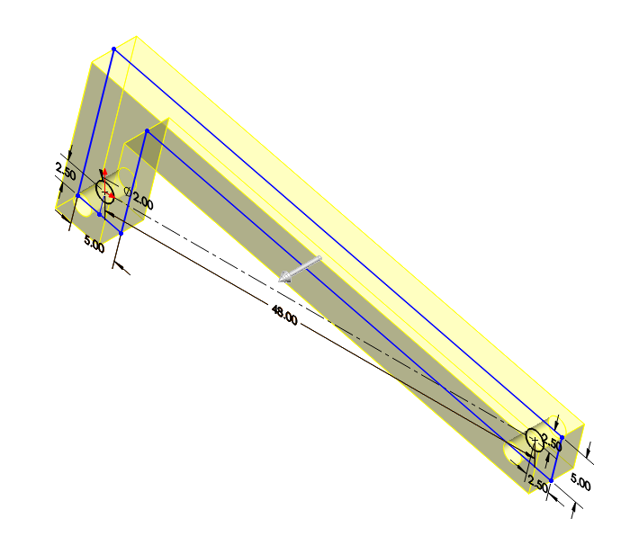
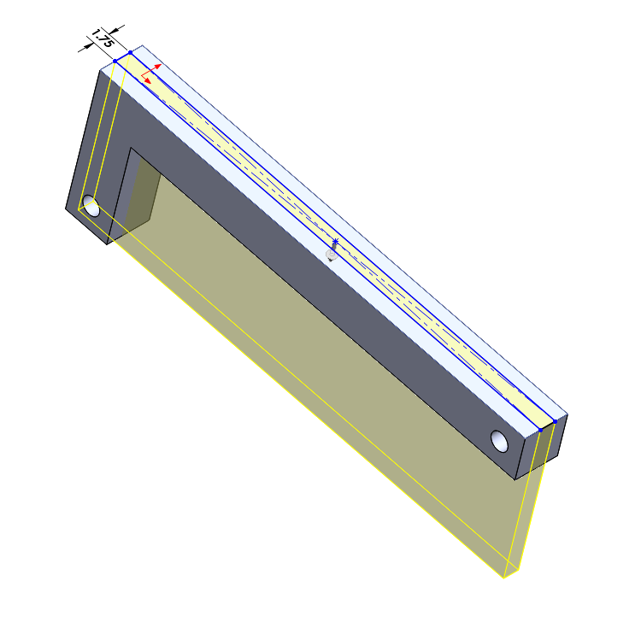
Modeling
Update 1
I started the frame by modeling the bottom part, referencing it to my original sketch. I ensured the holes are aligned horizontally and there’s room to place the seats and battery.

Slide 11
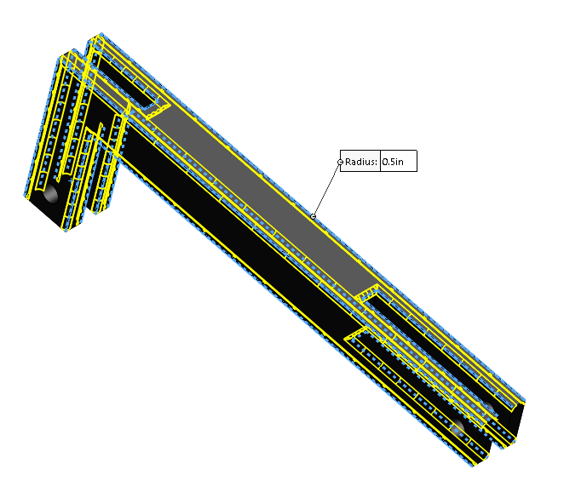
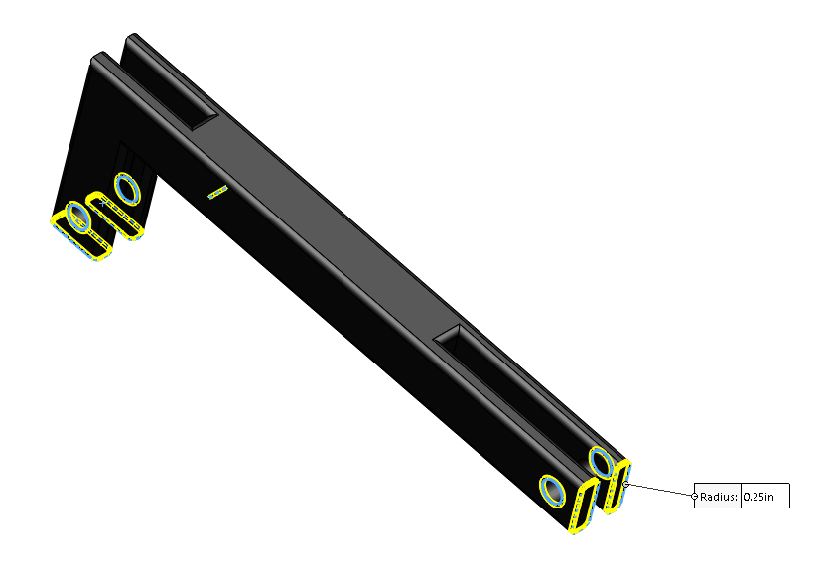
Modeling
Update 1
I filleted the sharp edges of the frame to make the model seem more realistic.

Slide 12
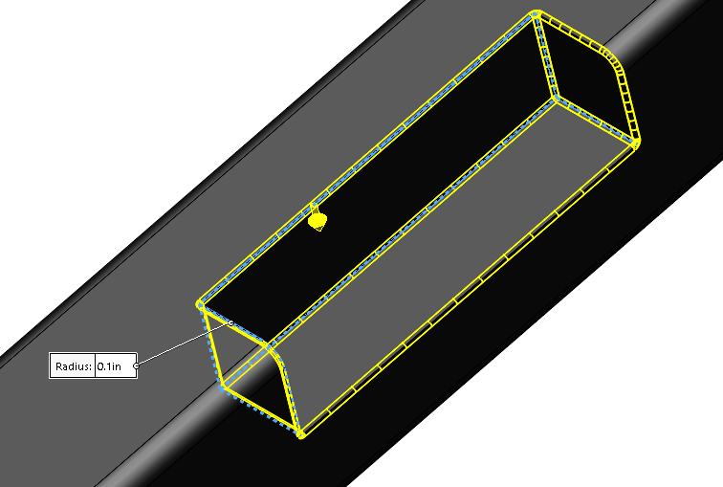
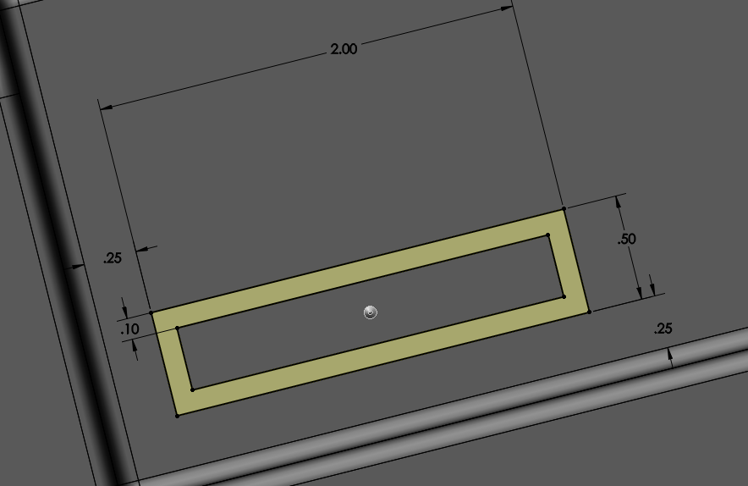
Modeling
Update 1
I then extruded a part of the bottom frame for a place to fit the battery into. I added arbitrary dimensions since it’s not confirmed yet, and that it would not be shown on the outside visually anyways.

Slide 13
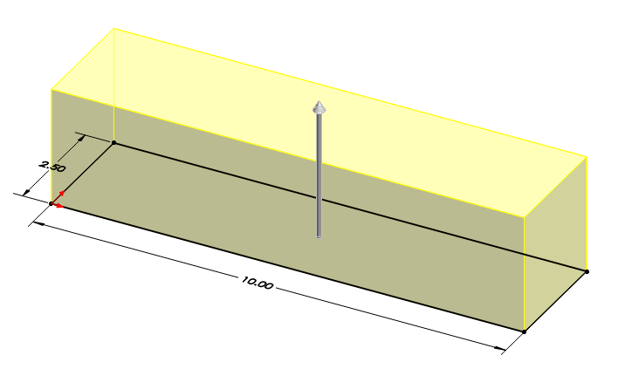
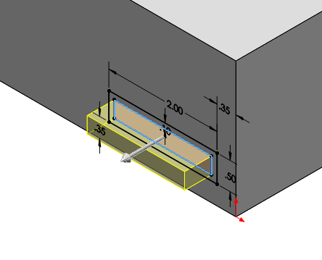
Modeling
Update 1
Here, I started modeling the battery, which is detachable in the assembly. I started out by creating a rectangular prism and adding details into it as I go on.

Slide 14
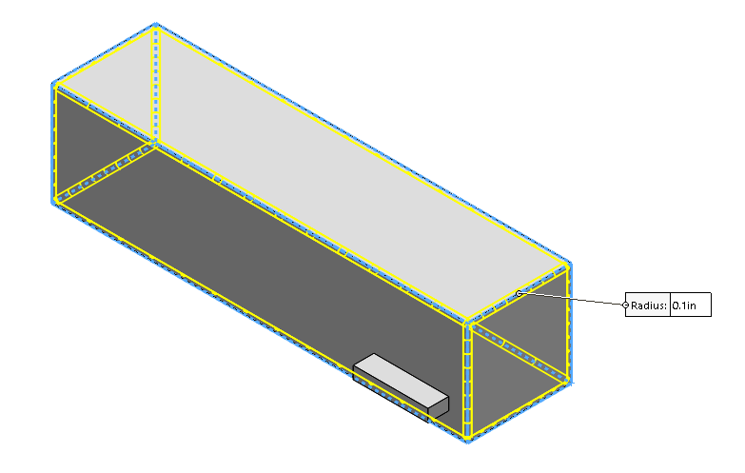
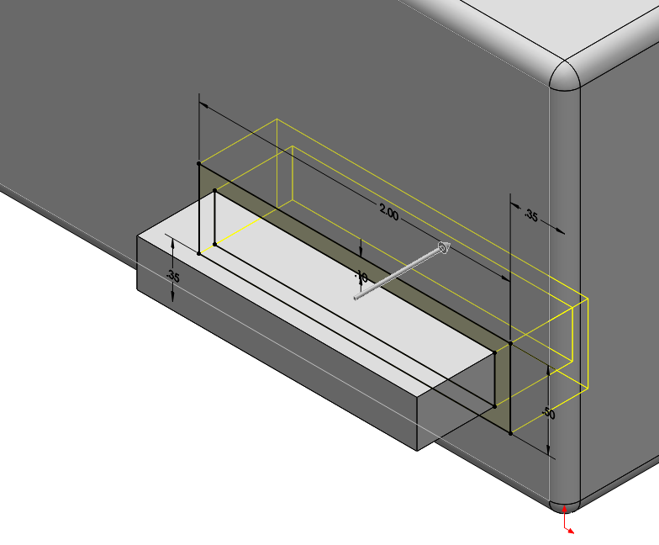
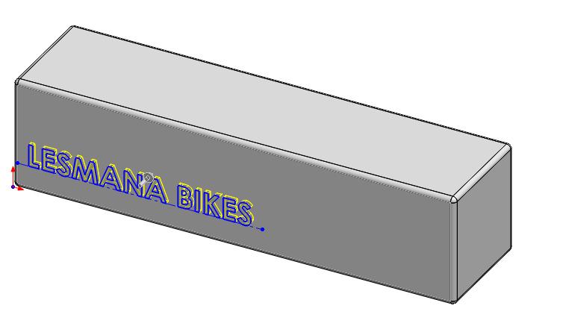
Modeling
Update 1
I then filleted the sharp edges again, and extruded in a part where the battery would connect into the bottom frame itself. I then extruded “LESMANA BIKES” onto the battery, just for the visual appearance.

Slide 15
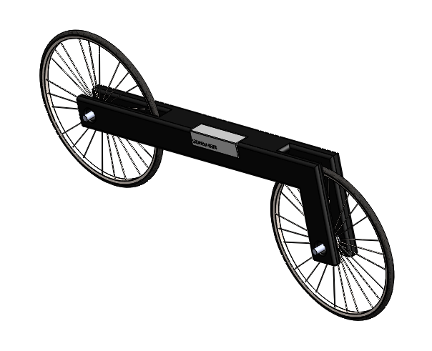
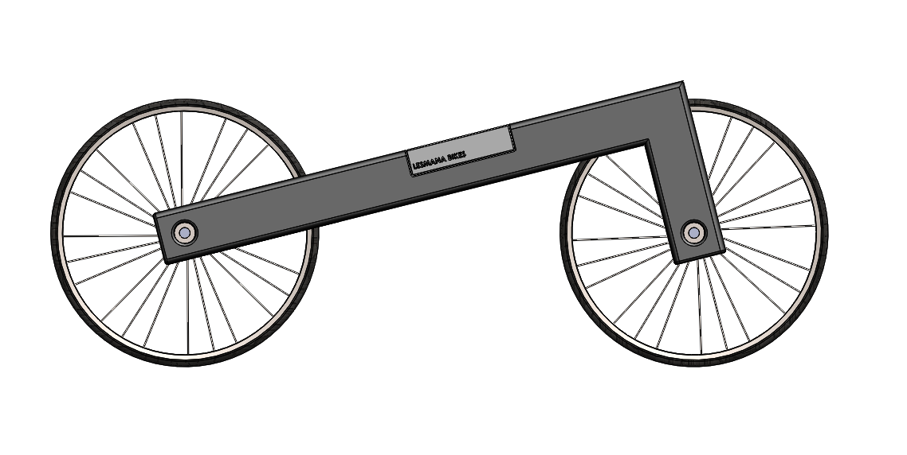
Modeling
Update 1
This is the assembly for my bike in general. I attached the wheels together with an arbitrary connector. The battery also fits with the frame perfectly firm and snug. (The frame is flipped intentionally from my original sketch).

Slide 16
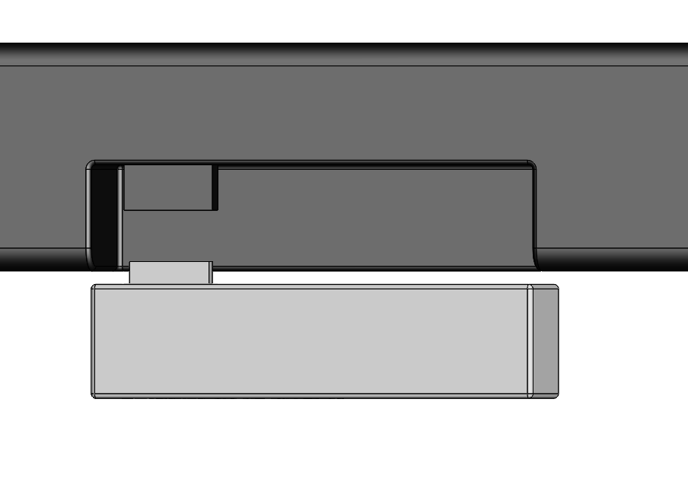
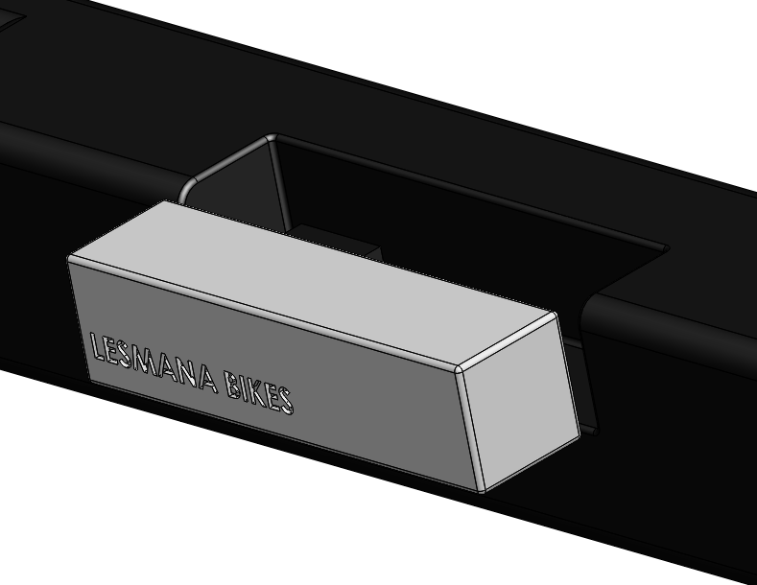
Modeling
Update 1
This is how the battery attaches to the frame.

Slide 17
Modeling
Update 2
After modeling for a while, I realized a silly mistake that I made with my project. While thinking about designing the handle bar and how to make the wheels rotate, I figured out that my design has one flaw which is the part where the wheel can’t turn. This is caused due to the whole body frame being attached together as one piece which also connects to the wheel.

Slide 18
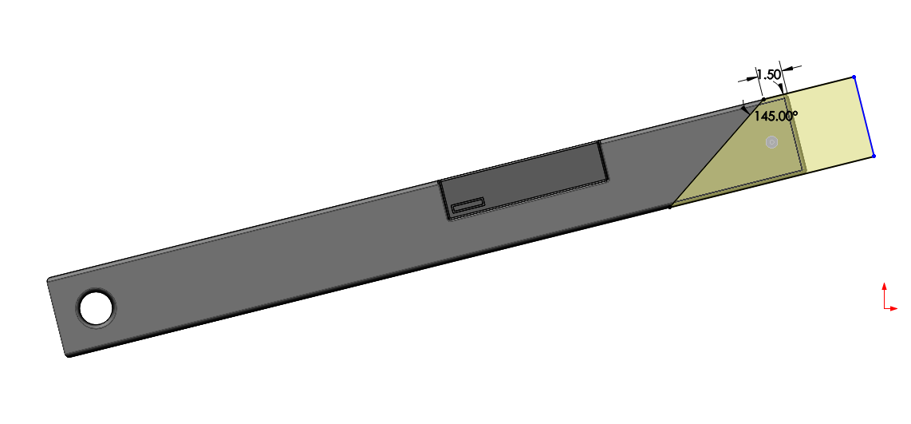
Modeling
Update 2
In order to fix this, I could’ve simply adjusted my Cut-Extrude feature, however, I decided to use this mistake as an improvised “design” which I then implemented onto the bottom body frame. I did so by adding another Cut-Extrude feature on the extra length, which I plan to shorten and add a separate part for the wheels which connects to the top part of the body frame (rotatable now).

Slide 19

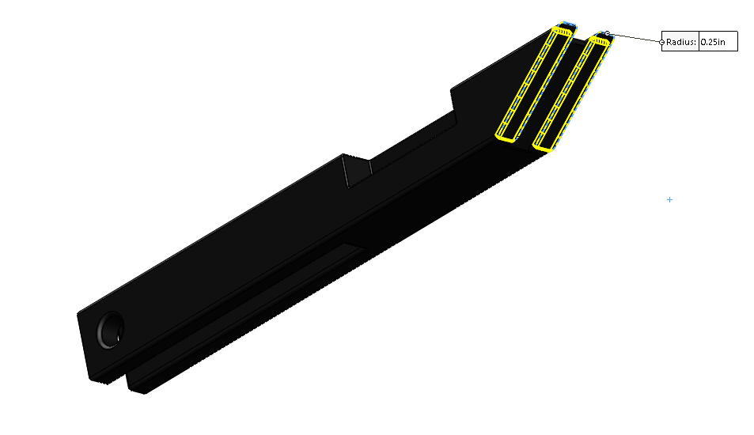
Modeling
Update 2
I then fileted the design to ensure all the sharp edges are fixed. I feel like the bottom part of the frame is finished for now. The only thing I’m missing is a way to connect it to the top part of the frame, which I then decided to create connectors where the top part could attach to the bottom part.
Connector
Top Frame
Bottom Frame

Slide 20
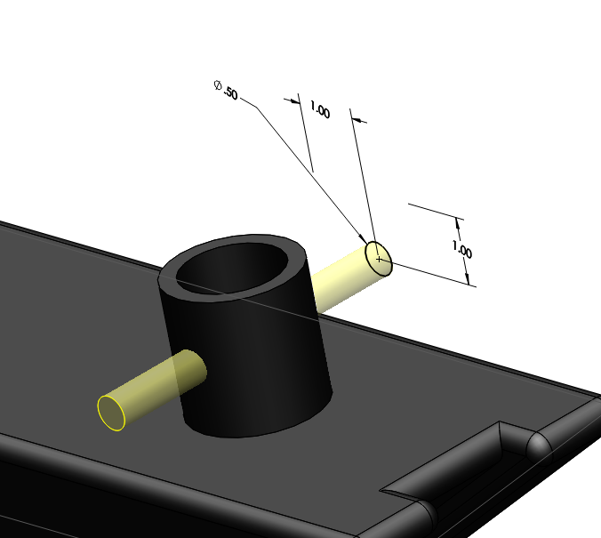
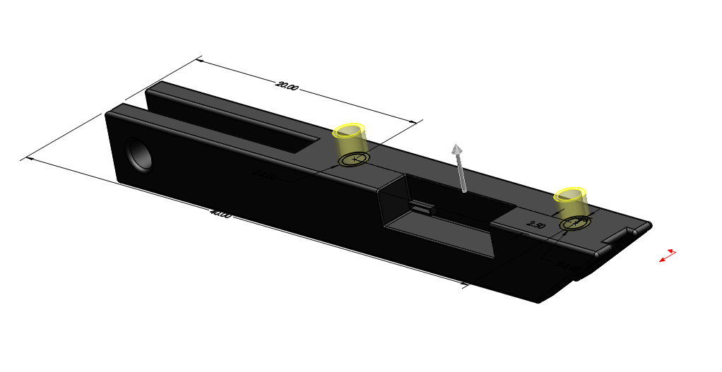
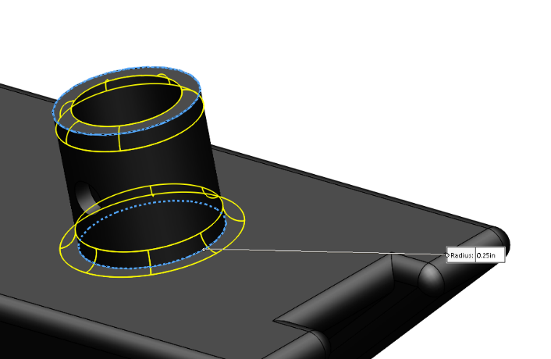
Modeling
Update 2
I started modeling the connectors by having a cylindrical Boss-Extrude, fileting them, and then cut in a hole through where the part from the top frame could attach to.

Slide 21
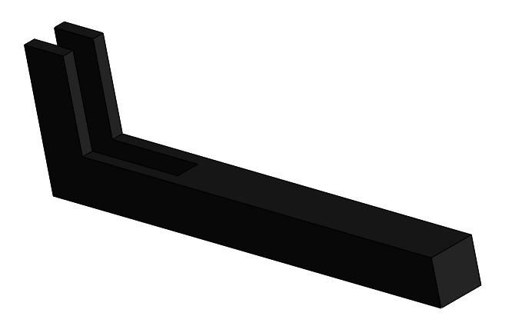
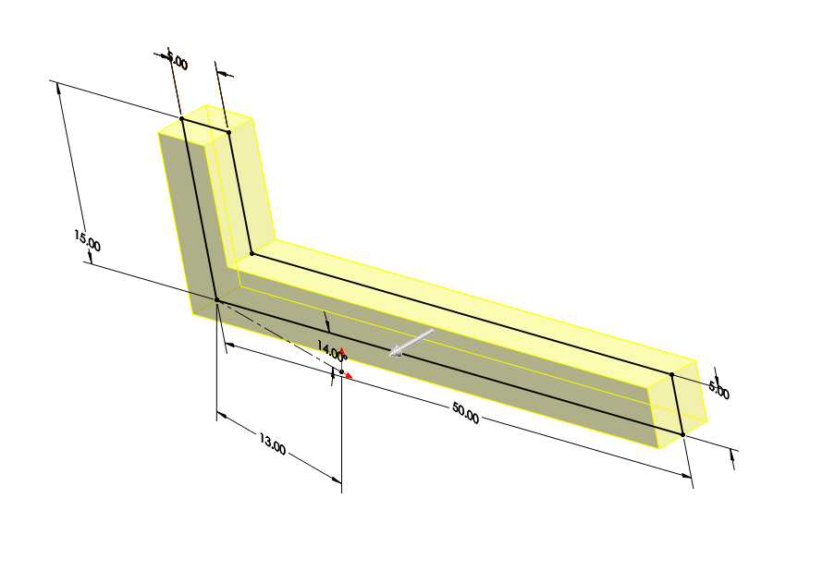
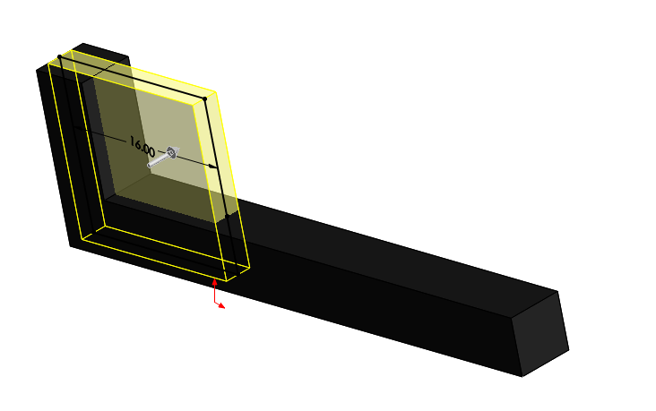
Modeling
Update 2
After finishing the connector parts, I decided to start on the top part of the frame. I created a similar L-Shape just like how I drew it in my original sketch.

Slide 22
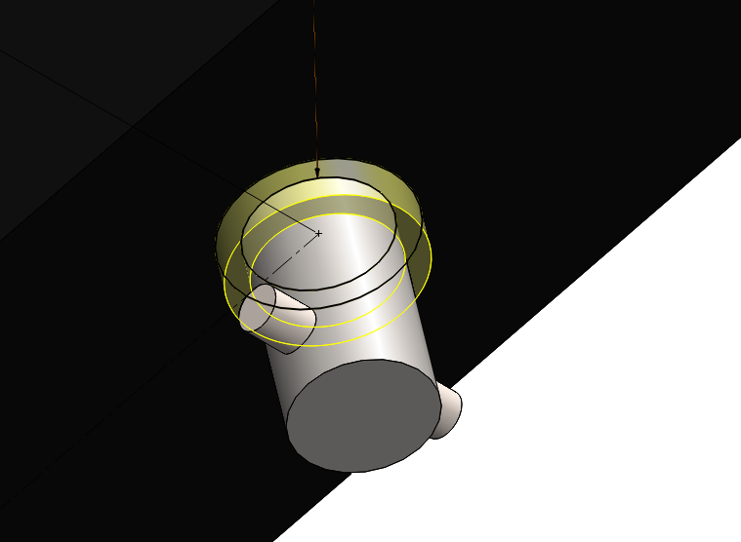
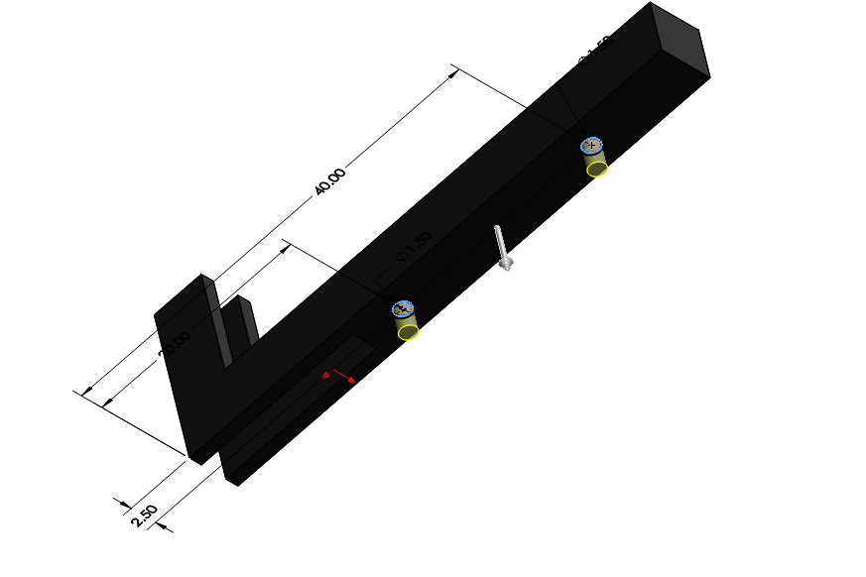
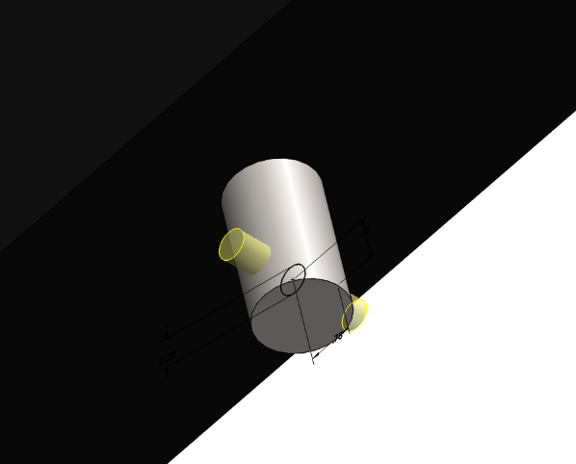
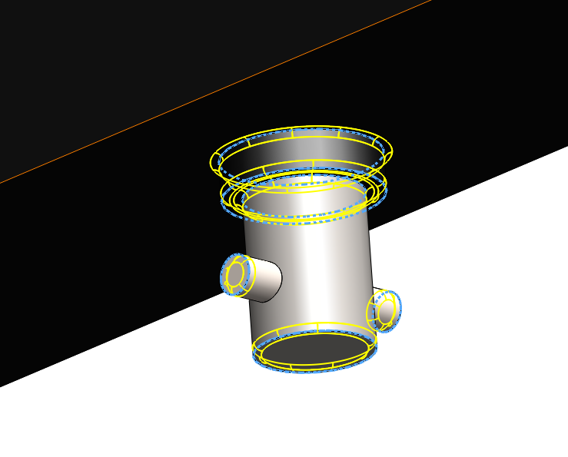
Modeling
Update 2
After creating the base of the top frame, I started to extrude out the bottom connector parts for the part to attach to the bottom frame piece that I made earlier. I made a similar cylindrical extrude that would fit into the hole on the bottom part.

Slide 23
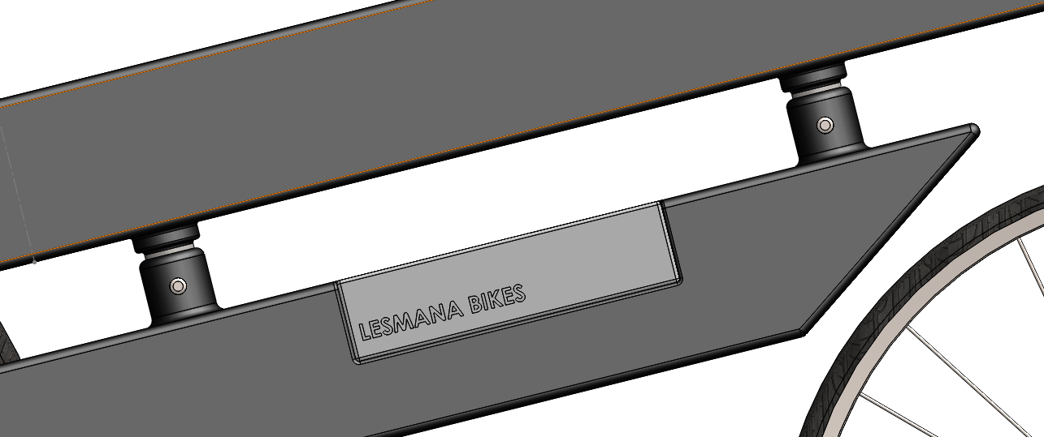
Modeling
Update 2
Now in the assembly, I can fit the two pieces together and the bike is slowly coming together.

Slide 24
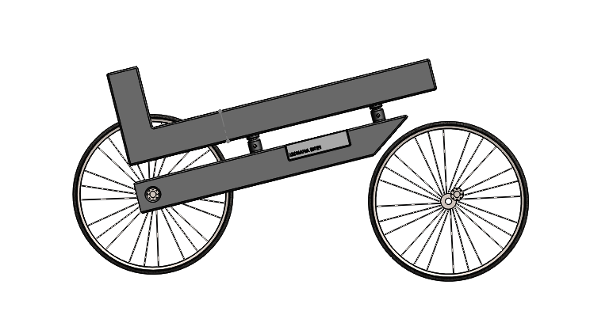
Modeling
Update 2
This is how the bike looks so far. The front wheel isn’t attached to anything yet since I still haven’t created that part, however, it will be attached when I finish the handlebar and the remaining parts.

Slide 25

Planning
Update 2
There are a few more parts that I have to get done in the upcoming two weeks. One of them would be the bottom part (chains, pedals, gears to the wheels, etc...) I’m planning to finish that in a few days and once I’m done with those features, I’ll focus on the top parts (handle bars, seats). After that I’ll probably be working on more visual details such as wiring and other things like so. Aside from that, I think the bike should be finished and be ready to render.

Slide 26
Modeling
Update 3
Picking up from where I left off last week, I decided to follow my planned route and focused on the handlebar and seat. There’s two places where I decided to place my seat and handlebar, which they all connect to the top frame of my bike.

Slide 27
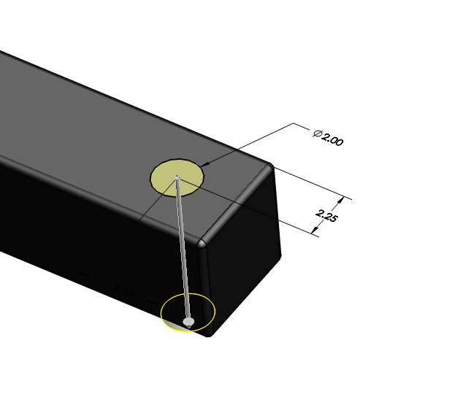
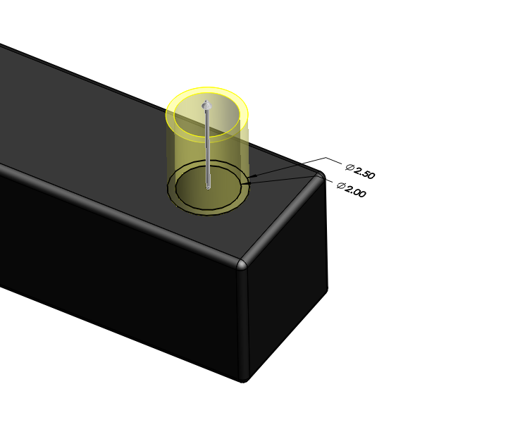
Modeling
Update 3
I need a place to attach my handlebar to the bike, so therefore I decided to extrude-cut a cylindrical hole in the top handlebar part. There would be a system inside the hole in the top frame which would stop the handlebar from falling, however, since it is concealed inside and wouldn’t show visually, I decided to just create a simple hole and maybe spend time on it if I have extra time.

Slide 28
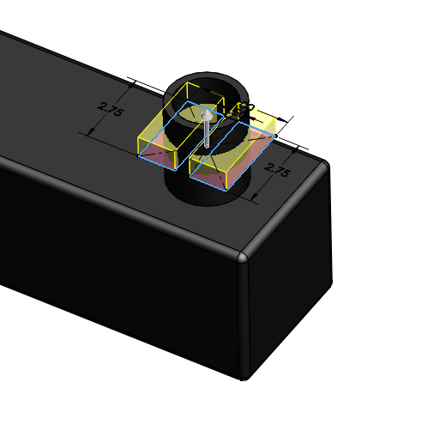
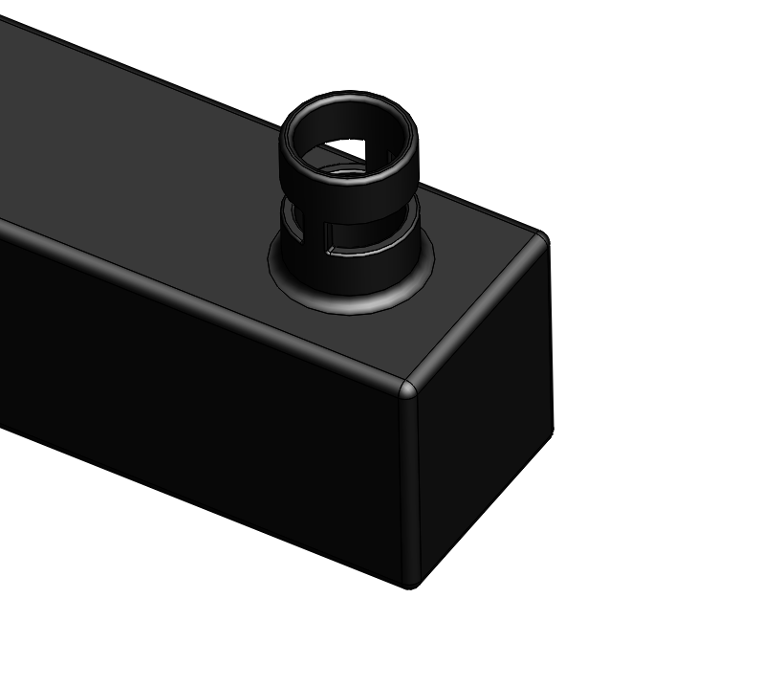
Modeling
Update 3
I then added a locking system to the handlebar slot to ensure that the handlebar doesn’t move up and down while riding the bicycle. It does limit the turning capabilities so it wouldn’t go to a full 90-degrees, however, realistically no one would turn a complete 90-degrees in a real bike. I then filleted the edges so they wouldn’t be too sharp.

Slide 29
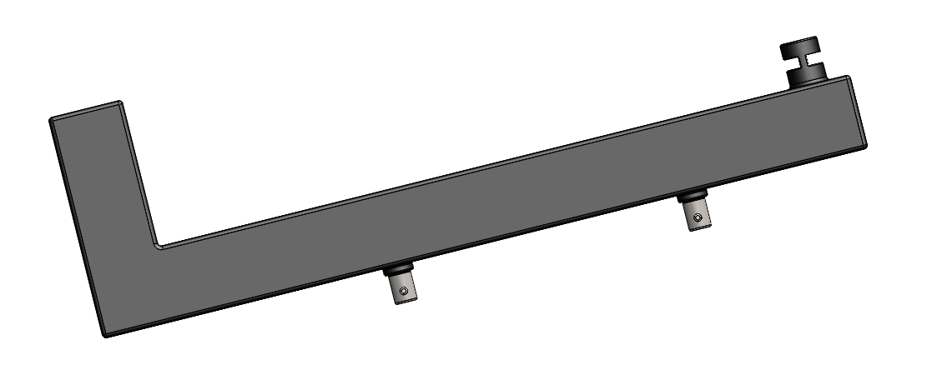
Modeling
Update 3
So this is how the top body frame part looks like currently from the front view.

Slide 30
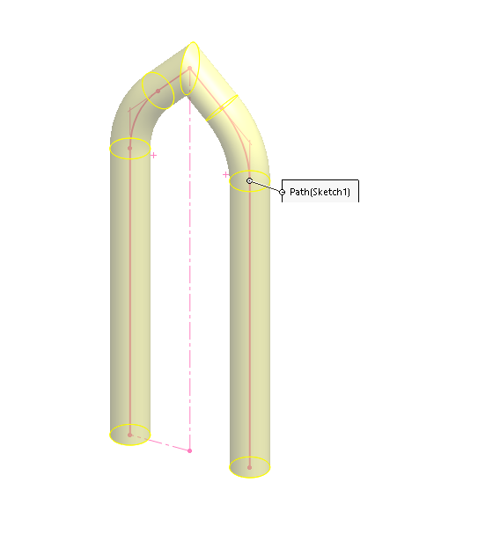


Modeling
Update 3
I started creating the handlebar by creating a sweep and creating the bottom handlebar part so it would be able to attach to the wheel. I then filleted the curves on the sweeps to ensure they don’t look as awkward.

Slide 31



Modeling
Update 3
I then cut-extruded 2 holes: one would be for the top part of the handlebar to insert into for the turning capabilities; the other would be the holes where the inner handlebar could adjust its height. I then extruded a stud where it could also connect to the top body frame part, where I created the piece for earlier.

Slide 32
Modeling
Update 3
This is where the stud would attach to in the top body frame part.

Slide 33


Modeling
Update 3
This is how the final piece of the bottom handle bar looks like. This is how it would look like attached to the full assembly.

Slide 34



Modeling
Update 3
I then started to create the top handlebar, which would attach to the bottom handlebar part. I started out by utilizing a 3D-Sketch and creating one side of the handlebar. I then did a circular profile sweep and mirrored the feature.

Slide 35


Modeling
Update 3
After I mirrored the handlebar, I then added the stud for it to attach to the bottom handlebar part.

Slide 36





Modeling
Update 3
After I have the handlebar structure, I started to create the grip and the brake handles. I did so by just doing some simple cylindrical extrudes and mid-planar extrude. I then mirrored them to the other side. The cables for the brakes would go inside the slot structure and down the handlebar.

Slide 37


Modeling
Update 3
I attached the handlebars together and assembled all of them together. The bike now has full functionality to turn the front wheels.

Slide 38



Modeling
Update 3
I started out creating the seat for the bike by extruding a flat seat-shaped structure and extruding it out. I then extruded a tad bit of the seat to make it look like a seat design. Then I filleted the edges so it seems more realistic.

Slide 39


Modeling
Update 3
I extruded the connector to the seat so it could attach to the top frame part. I also extruded a stud so it would be height adjustable.

Slide 40



Modeling
Update 3
I started modeling the top body frame part where the seat could be inserted to and attach into.

Slide 41

Assembly
Update 3
I attached the seat to the bike and the final assembly currently looks like this. The handlebar is fully functional where the wheels would turn in the assembly; the seat and handlebar height could also be easily adjusted.

Slide 42


Comparison
Update 3
This is how the Solidworks model compares to the original hand-drawn sketch. As seen below, the handlebar is different from what I’ve originally planned, however, I seem to like my new design more. The seat is similar to the fact where it would attach to the top body frame and have a little connector. The battery pack is still visible and the only thing that’s missing is the chain and pedals. Another difference is how the bottom frame doesn’t connect to the wheel, but then again it wouldn’t allow the wheel to turn so I had to remove that.

Slide 43

Planning
Update 3
In the next week, I plan on finishing the whole bike and the renders. With that amount of time, I could possibly fix up the minor details and do some adjustments to make it seem more realistic. I will also add the pedals and the chain in the assembly. Hopefully this project could be done in the next update, since I’m not really missing as many components anymore and the bike is coming along together.

Slide 44



Modeling
Update 4
I started the week off by adding the chains, crank, pedal, and many other components to the bottom of the bike. I decided that I want to attach such components to the bottom frame of my bike, which is what I did. I extruded out a shape with the bottom face parallel to the ground where I will attach all the components into.

Slide 45


Modeling
Update 4
I filleted the edges of the part and created a whole where the gear would attach into. Of course, to create realism, I filleted the sharp edges on the component. After finishing this part, I started to work on the gear where the pedals would attach to. I started by creating a gear by extruding out a circle and adding a circular pattern to little triangles.

Slide 46



Modeling
Update 4
After creating so, I started to extrude out the rods where the pedal would be able to rotate around. After creating this to one side, I did the exact same thing to the other side. However, I avoid mirroring this feature since it wouldn’t be completely symmetrical
Pedals go here

Slide 47




Modeling
Update 4
I started creating the pedals afterwards, starting out by extruding a rectangle. After so, I started doing extrude cuts inside to achieve the pedal look and created a hole where it would fit inside the crank. Then again, I filleted every sharp edge again for realism purposes.
Attaches to crank here

Slide 48


Modeling
Update 4
To create the chains, I used my teacher’s (Mr. Dickie) chain link that he provided for use. However, I noticed that the gap wouldn’t fit the gears on the crank that I created. Therefore, I modified it with different features to ensure that it would fit properly to the gears.
Original
Modified

Slide 49

Assembly
Update 4
I assembled everything together and the bike looks about finished. I mated the pedals and the rods concentric to each other, did a curved path for the chain links, and attached the gears together accordingly. I also fixed minor details and parts in order to create more realism.

Slide 50

Renderings
Update 4

Slide 51

Renderings
Update 4

Slide 52

Renderings
Update 4

Slide 53

Renderings
Update 4

Slide 54

Renderings
Update 4

Slide 55

Comparison
Update 4
Final Product
Initial Sketch

Slide 56

Logo Comparison
Update 4

Slide 57

Conclusion
Update 4
There’s much to be said about this project. At first, when our instructor assigned this assignment, I figured that I wouldn’t be able to finish. It turns out that I did, which is surprising and I’ve learned that completing things one by one, ensuring they work properly, would be one of the best ways to handle such a large assembly like so. I have to say, I underestimated myself on my timing and turns out that I’ve completed the project within the assigned time. The lesson I took away from this project is that no matter how hard a project seem like in the very beginning, hard work and dedication could definitely finish the work on time. Aside from that, I got to learn different components about bikes, the different types and designs, and how they function.
I have gotten mixed feedback from others about my bike, such as “it looks strange” or “it’s a weird design.” Yes, I admit, this design doesn’t look like your typical bike that you would see around, however I’m very proud of it. While constructing my project, I have looked around the room of around 30 or so students and I’ve seen some them trace bikes they found online and replicating them (including components such as frames and handlebars). Even though my bike looks strange or weird, I’m very proud that I could come up on a design in my own head, which reflects pure creativity. I’ve based this design on my logo, comparison on previous slide. Overall, this project is definitely a tremendous challenge that I’ve accomplished which I’m very proud of. ~

